Slide 1
Integrating Image Captioning and Generation with Gradio and Hugging Face API
Jubaida Tasnim

Slide 2
Table of Contents
Introduction
Design
Implementation
Test
Story from Image
Enhancement Ideas
Conclusion

Slide 3
Introduction
Project Purpose: Developing a generative AI application that combines image captioning and generation, designed as a game app. This app leverages Gradio for UI components and Hugging Face API for image-to-text and text-to-image functionalities.
Background: Part of a lesson on building AI-driven apps for NLP and image-based tasks, this project serves as a hands-on exercise to understand API integration, Gradio UI, and iterative game development.
Scope and Objectives:
Build an engaging, interactive experience that generates captions for uploaded images and creates new images from text captions.
Use an intuitive and streamlined interface that encourages users to explore multiple iterations of captioning and image generation.

Slide 4
Design
Purpose of Design Decisions: Explaining the “why” behind each decision in the app's design and development.
Identify and Understand the Problems:
Problem: Create an engaging game experience that utilizes AI for both image captioning and generation.
Requirements: Easy-to-use UI (Gradio) that allows seamless transitions between captioning and generating images.
Constraints: Ensure the application integrates well with Hugging Face API for image-to-text and text-to-image processes.

Slide 5
Investigate Possible Solutions:
Solution 1: Use separate APIs for image captioning and generation.
Solution 2: Integrate both APIs in a single streamlined game loop to enhance user experience.
Solution 3: Experiment with combining captioning and generation in a single click to simplify user interaction.
Theoretical Comparison:
Solution 3 was selected as the best option to improve user flow by allowing both captioning and generation in a single step.
By using Gradio Blocks and function integration, the app creates a cohesive experience that keeps users engaged.

Slide 6
Implementation
Implementation Approach:
Developed using Gradio for the frontend UI, providing interactive elements such as image upload, caption generation, and image creation.
Functions:
captioner: Captions an uploaded image by converting it to base64 and sending it to the Hugging Face image-to-text API.
generate: Takes text input to generate an image using the text-to-image API, decoding it back into an image.
caption_and_generate: A combined function to allow captioning and generation in one action.
Challenges and Adaptations:
API Integration: Required setting up endpoint URLs and authorization using environment variables.
UI Streamlining: Combining captioning and generation into one function simplified the game interface and improved user flow.

Slide 7
Test
Testing Methodology:
Performed unit tests on API responses to ensure both captioning and image generation functions were working correctly.
Tested the UI by running the Gradio Blocks interface locally to validate that user inputs (image upload, caption text) triggered the correct responses and outputs.
Edge cases: Tested with diverse image inputs to ensure robustness of caption generation and image variety.
Key Findings:
The single-step caption and generate button streamlined the user experience.
Observations from testing led to optimizations in image loading and response handling, enhancing performance.

Slide 8
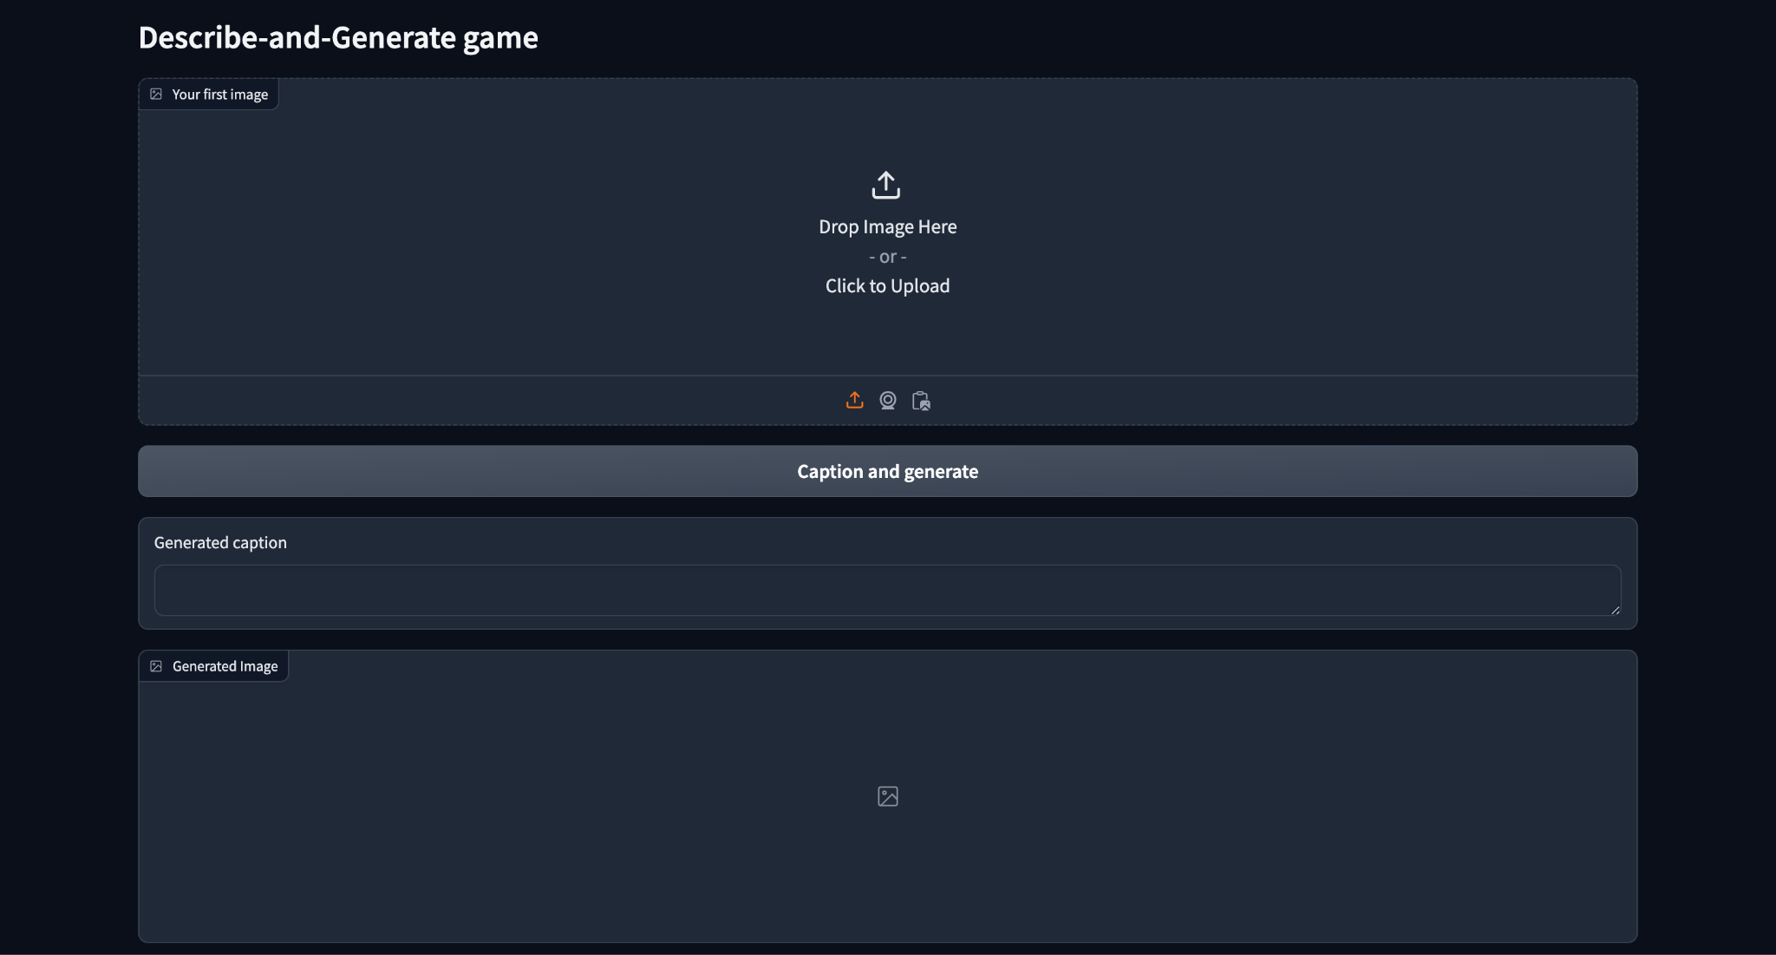
Story from Image

Slide 9
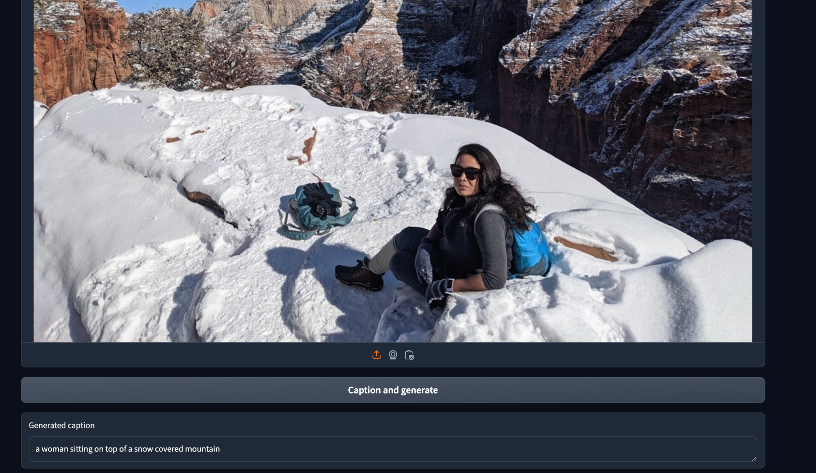

Slide 10
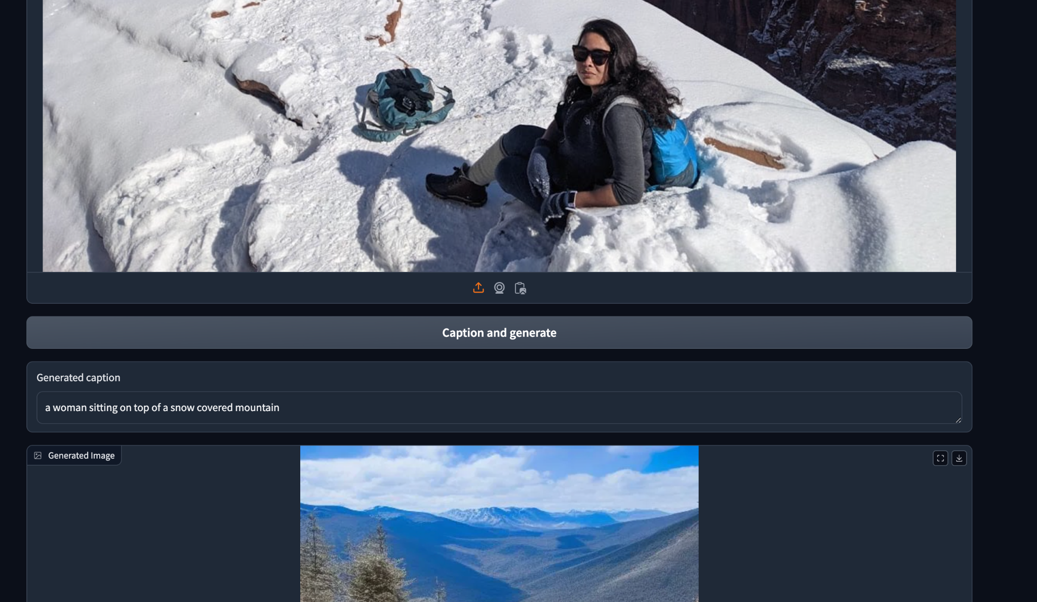

Slide 11
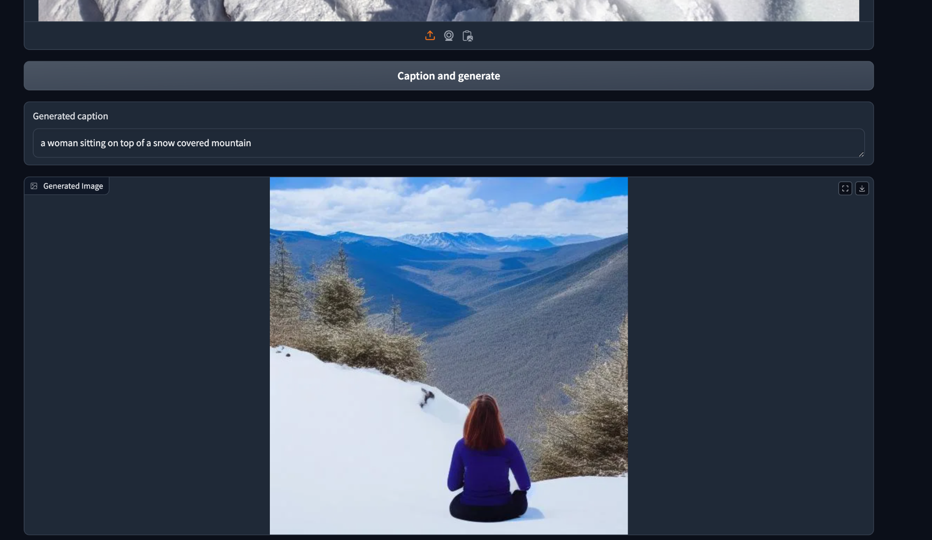

Slide 12
Enhancement Ideas
Potential Improvements:
Additional APIs: Experiment with different image generation models for enhanced variety or quality.
UI Enhancements: Add options for users to adjust generation parameters (e.g., style or theme).
Continuous Game Loop: Allow users to chain multiple generations to build a story or sequence.
Long-term Vision:
Create a multi-functional AI-driven game that can be expanded with features like voice prompts, interactive character responses, and customizable image outputs.
Integrate feedback mechanisms to collect user preferences, allowing the model to evolve based on user interaction.

Slide 13
Conclusion
Summary of Outcomes:
Successfully built a generative AI game that demonstrates the integration of image captioning and generation in an interactive UI.
This project highlights how AI tools like Hugging Face API and Gradio can be combined to create engaging user experiences.
Reflections:
Through this project, insights were gained into optimizing API calls, designing user-centered UIs, and handling iterative image generation in a game loop.
Valuable hands-on experience with Gradio Blocks and API response handling.
Final Thoughts:
This project is a stepping stone toward more complex AI-driven applications.
Future improvements could make the app more adaptable to different creative uses, pushing the boundaries of generative AI in game design.

